Slide 1
Comprehensive Image Processing And Boundary Analysis Image Acquisition: * Capture Or Download An I
SlideMake.com

Slide 2
Introduction to Image Processing
Comprehensive image processing involves techniques to enhance, analyze, and interpret images.
Boundary analysis is a crucial component that focuses on identifying object outlines within images.
This presentation explores the methods of image acquisition, processing, and boundary detection.
Notes:
Image source: https://i1.wp.com

Slide 3
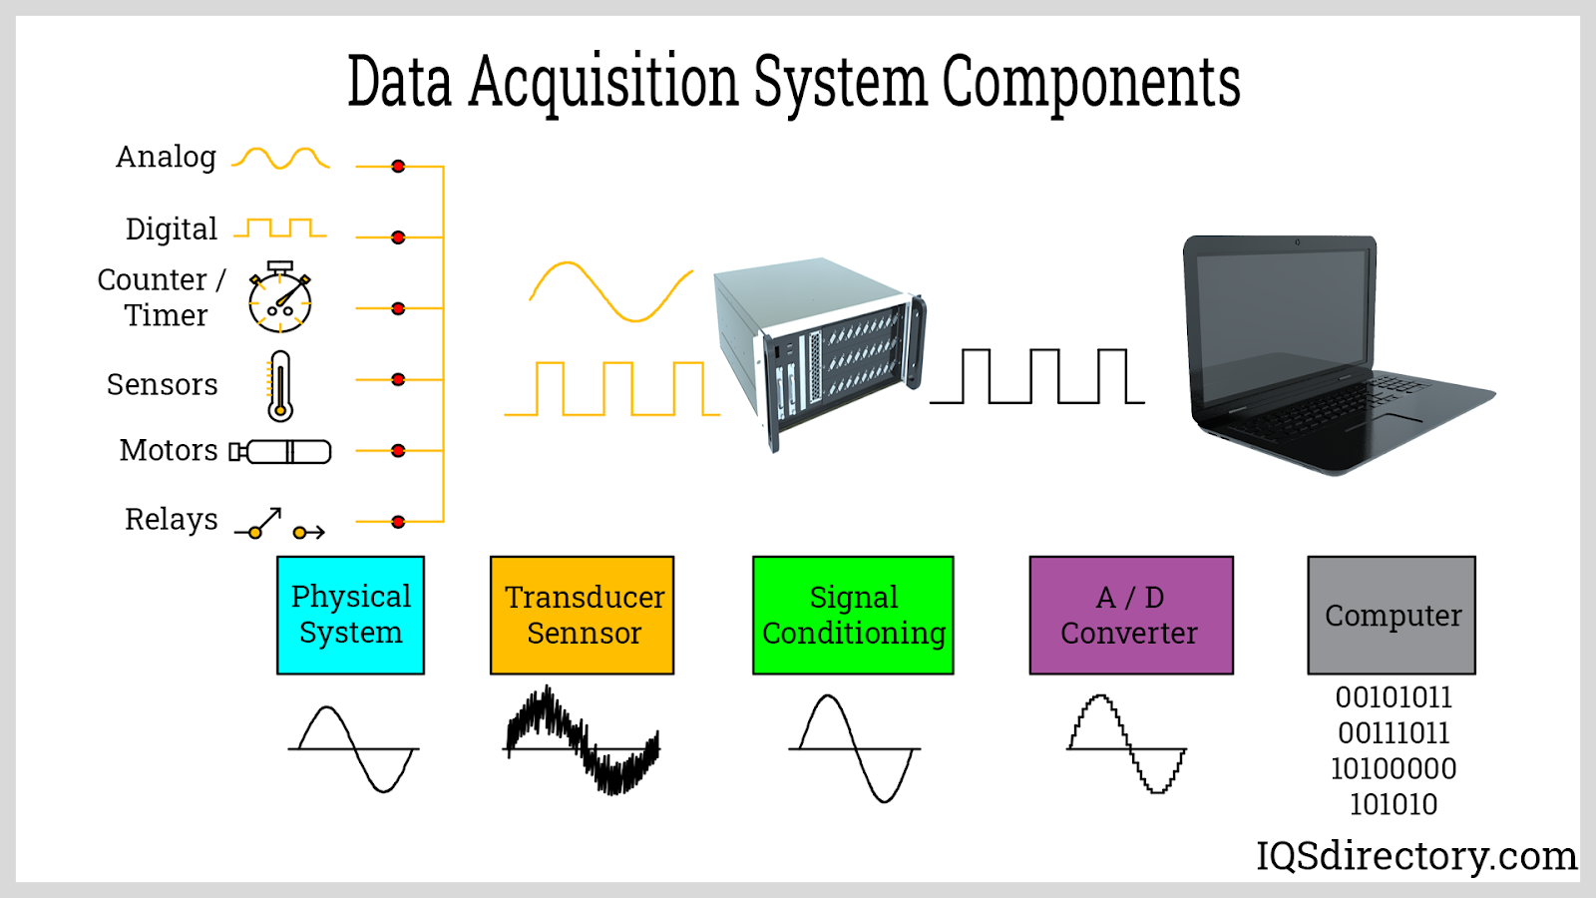
Image Acquisition Techniques
Image acquisition can occur through various methods, including digital cameras and scanners.
Images can also be acquired from online databases or through downloading from various sources.
The choice of acquisition technique can significantly impact the quality of the data collected.
Notes:
Image source: https://www.iqsdirectory.com

Slide 4
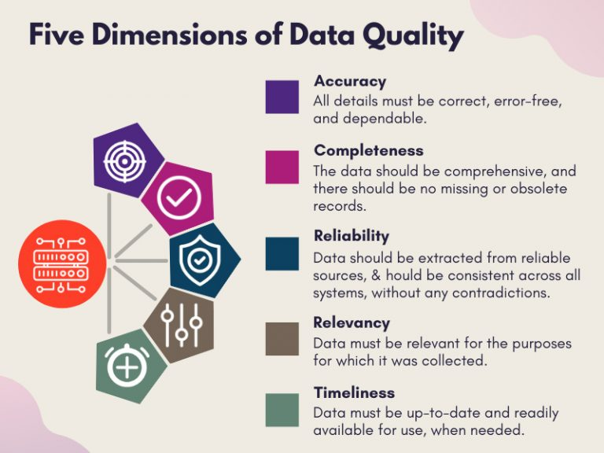
Importance of Quality in Image Acquisition
High-quality images are essential for accurate analysis and reliable results.
Factors such as resolution, lighting, and focus play a critical role in image quality.
Poor-quality images can lead to misinterpretation and inaccurate boundary detection.
Notes:
Image source: https://www.managedoutsource.com

Slide 5

Types of Image Formats
Images can be stored in various formats, including JPEG, PNG, TIFF, and BMP.
Each format has its advantages and disadvantages regarding quality, compression, and usability.
Understanding these formats is important for selecting the appropriate one for specific applications.
Notes:
Image source: https://www.maketecheasier.com

Slide 6
Preprocessing Techniques
Preprocessing is essential for enhancing image quality before analysis.
Common techniques include noise reduction, contrast enhancement, and histogram equalization.
These steps help improve the visibility of boundaries and features in the image.
Notes:
Image source: https://www.researchgate.net

Slide 7
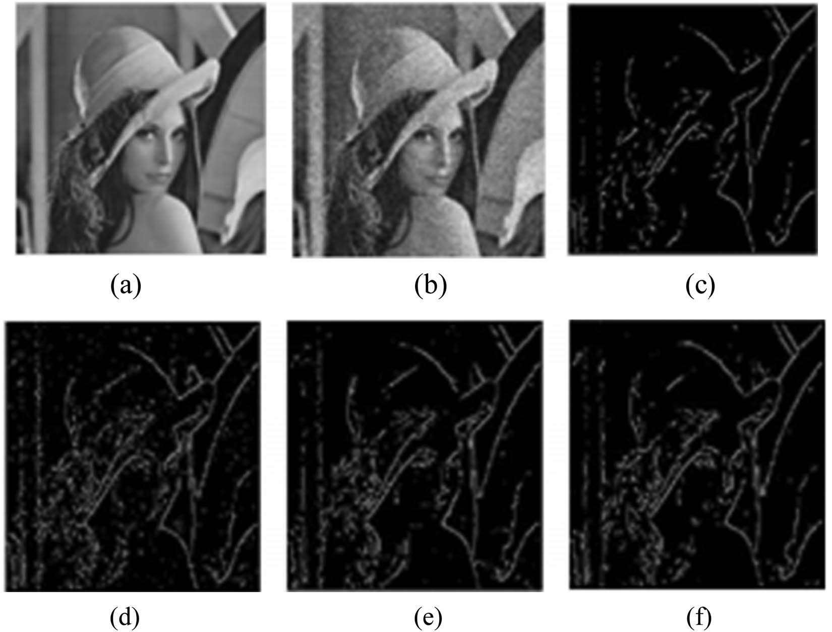
Boundary Detection Methods
Boundary detection methods include edge detection algorithms such as Canny and Sobel.
These algorithms work by identifying rapid intensity changes in an image.
Accurate boundary detection is vital for object recognition and image segmentation.
Notes:
Image source: https://www.degruyter.com

Slide 8
Image Segmentation
Image segmentation is the process of partitioning an image into meaningful regions.
This technique is crucial for isolating objects from the background for further analysis.
Various algorithms, such as thresholding and clustering, are employed for segmentation tasks.
Notes:
Image source: https://image.slidesharecdn.com

Slide 9
Applications of Boundary Analysis
Boundary analysis is widely used in fields such as medical imaging, robotics, and remote sensing.
In medical imaging, it helps in identifying tumors or other anomalies in scans.
In robotics, boundary analysis aids in navigation and obstacle avoidance.
Notes:
Image source: https://dragonflyaerospace.com

Slide 10
Challenges in Image Processing
Image processing and boundary analysis face several challenges, including occlusion and noise.
Variability in lighting and image quality can complicate boundary detection.
Ongoing research aims to develop more robust algorithms to address these challenges.
Notes:
Image source: https://pbs.twimg.com

Slide 11
Future Directions in Image Processing
Advances in machine learning and artificial intelligence are shaping the future of image processing.
Automated systems for image acquisition and analysis are becoming increasingly prevalent.
Future developments aim to improve accuracy, speed, and efficiency in boundary analysis.
Notes:
Image source: https://assets.entrepreneur.com

Slide 12
References
Gonzalez, R. C., & Woods, R. E. (2018). Digital Image Processing. Pearson.
Jain, A. K. (1989). Fundamentals of Digital Image Processing. Prentice-Hall.
Szeliski, R. (2010). Computer Vision: Algorithms and Applications. Springer.

